Slide 1
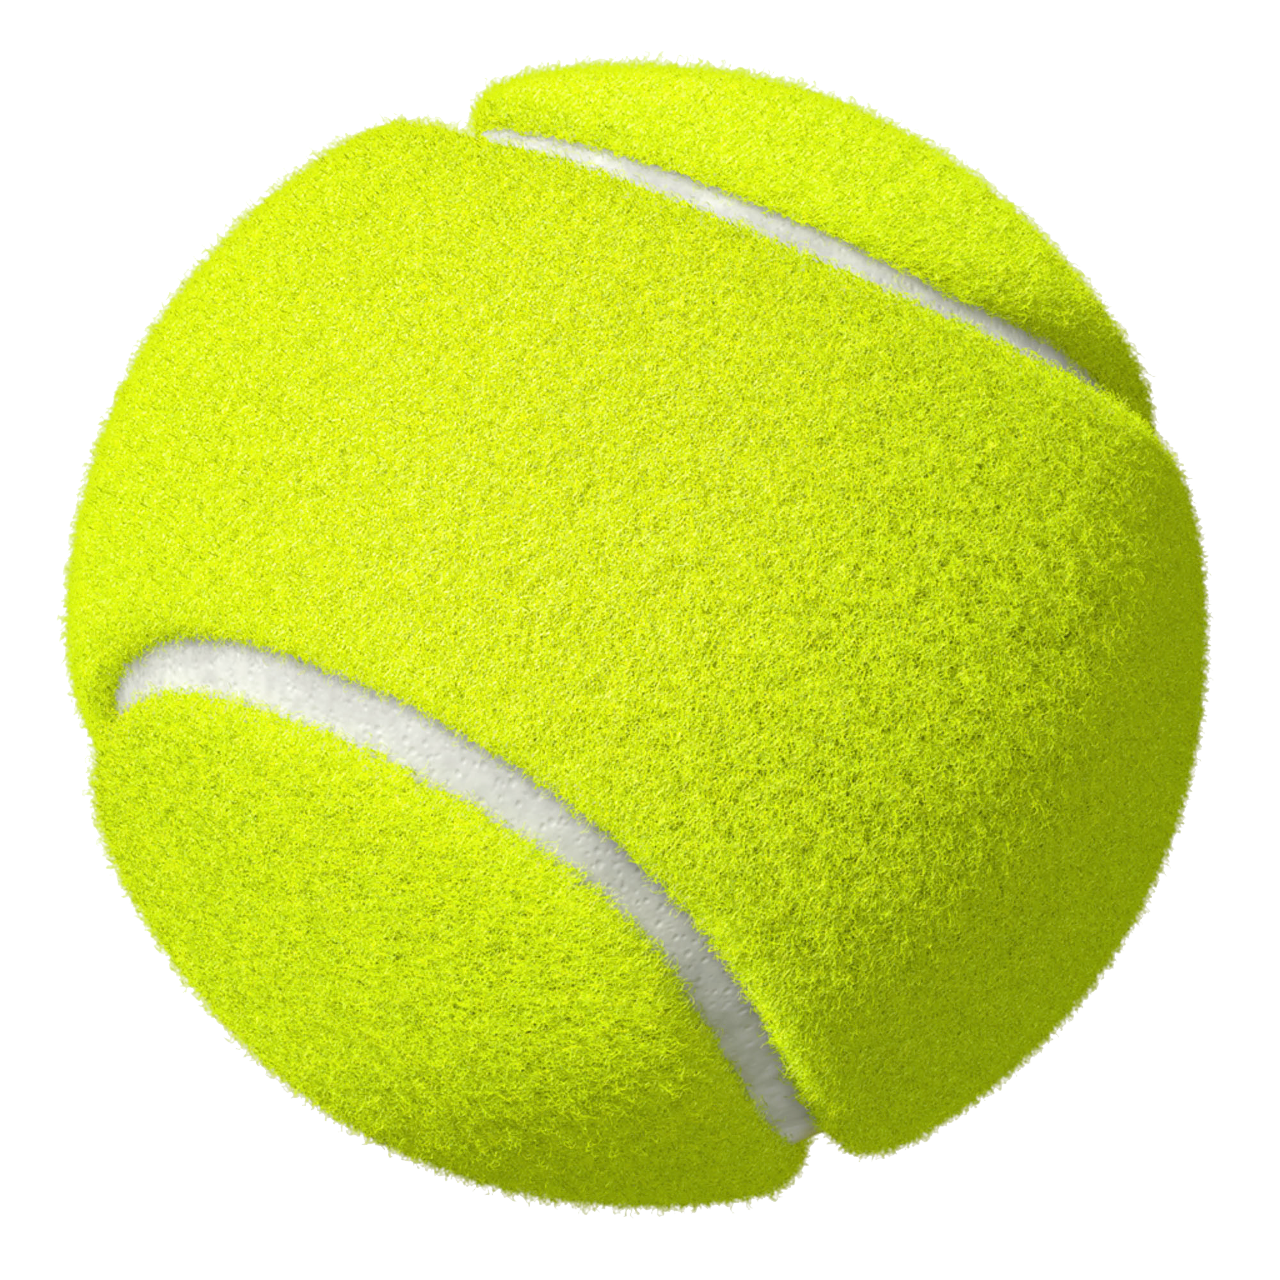

RACKET SCIENCE
TENNIS MATCH PREDICTION
AND
FEDERER THE GREAT
Notes:
Like most of the world, Team Racket Science loves sports, both watching and predicting the outcome. As data scientists we believe that we can leverage machine learning techniques to help predict the victor. We have used 20 years of pre pandemic Association of Tennis Professionals data to predict the outcome of a tennis match between two tennis players.

Slide 2

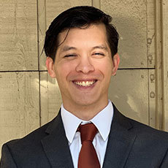
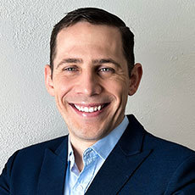
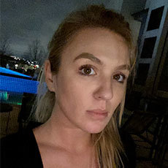
OUR TEAM
ALEJANDRO
VELASQUEZ
MASON SHERBONDY
DANIEL NORTHCUTT
CHLOE WHITAKER
Notes:
Now let me introduce you to team Racket Science My names is Alejandro Velasquez, Mason Sherbondy Daniel Northcutt And Chloe Whitaker

Slide 3
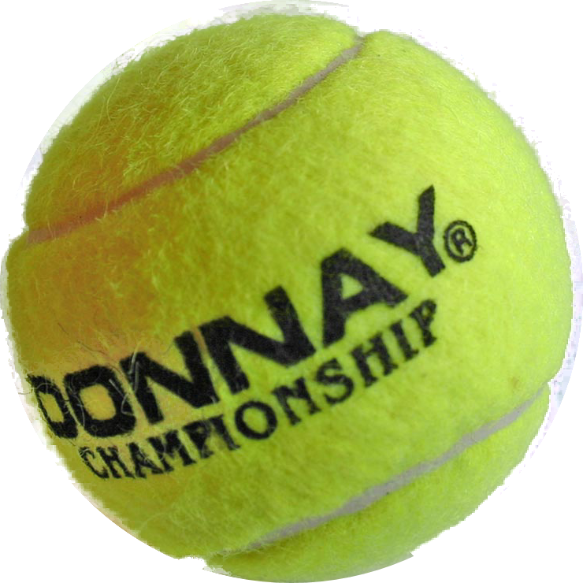
GAME PLAN
TENNIS BASICS
EXECUTIVE SUMMARY
& PLAN
ACQUIRE
& PREPARE
Alejandro
Alejandro
Mason
EXPLORE
MODEL
CONCLUSIONS
& NEXT STEPS
Daniel
Chloe
Alejandro
Notes:
For today's agenda, I will give you an executive summary, a quick intro to the game of tennis, and tell you about our gameplan
After me, Mason will tell you about the work that went in to acquiring and preparing our data
Daniel will talk about the exploratory work the team did
And the Chloe will let you know how we defined our baseline and created our predictive model
At the end, I will discuss our conclusions with you

Slide 4
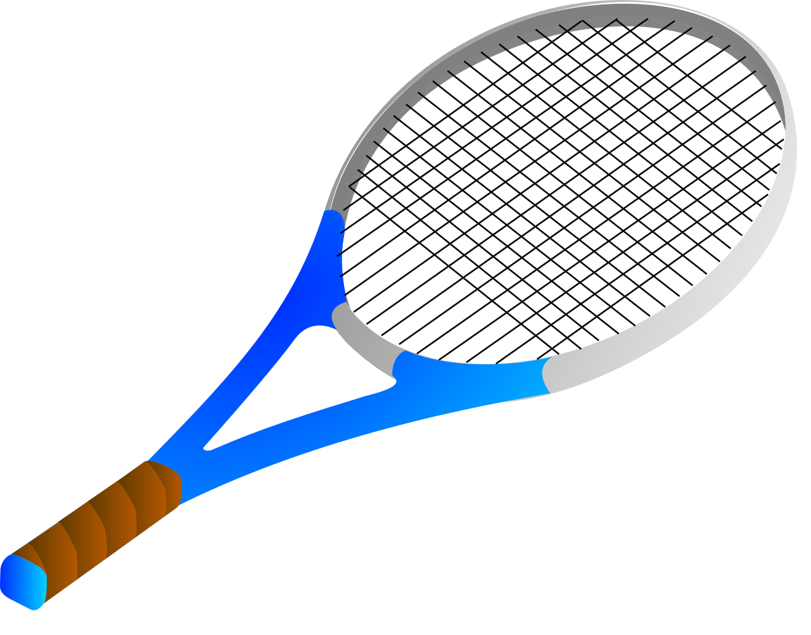
EXECUTIVE SUMMARY & PLAN
Alejandro Velasquez

Slide 5
EXECUTIVE SUMMARY
GOALS | QUESTIONS | FINDINGS/ TAKEAWAYS
- Predict winner of a tennis match - Roger Federer: - Drivers of Success - Can we predict his greatness? | Drivers of victory? Is Roger really one of the greatest? | - Top players work hard at: - Break points won - High Aces - First-serve points - Our model beats baseline - Some surface would give players statistical advantage
Notes:
Our team stabilized 2 main goals:
Predict the outcome of a match and discover what makes a player great. To accomplish our second goal, we focused on Roger Federer,one of the modern greats of tennis.
To do so we We asked ourselves What drives the success of a player And Is Roger Federer one of the best of the last 20 years?
In our journey we found that
Top players will win a lot of break points
Will ace their opnets a lot
and win their first serve points

Slide 6











OUR PROCESS
1 PLANNING
2 DATA ACQUISITION
3 PREPARATION
4 EXPLORE
5 MODELING
6 DELIVER
Notes:
For our project we followed the 6 steps of the data science pipeline.
We planned using Trello
We acquired our data using python and Github
To prepare our data we used Jupyter Notebooks, pandas and Numpy
To learn about our data we leveraged jupyter notebooks with seaborn and matplotlib
For modeling we used scikit learn
And deliver this presentation using google slides and slidesgo

Slide 7
TENNIS
BASICS
Alejandro Velasquez

Slide 8
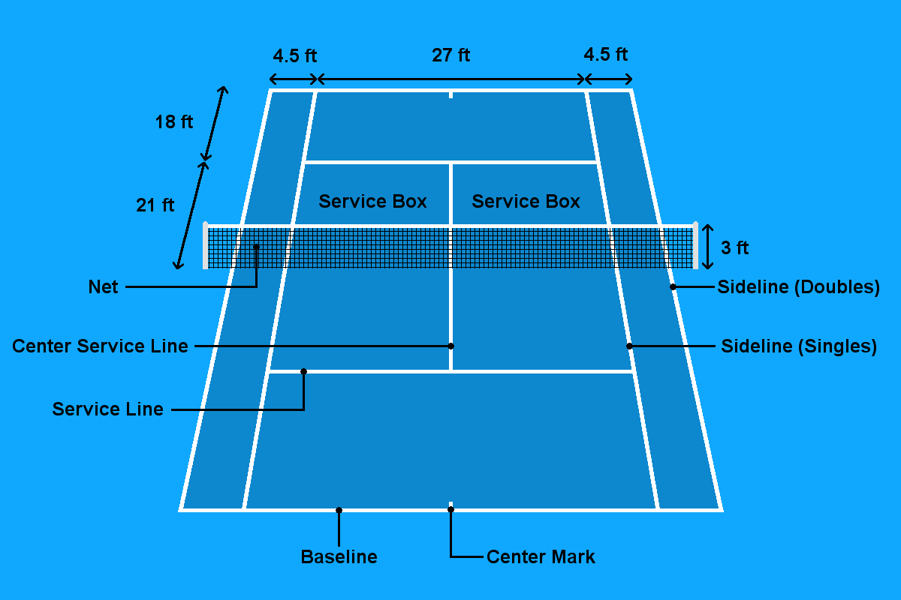

Deuce Half
Service box
Deuce Half
Notes:
Tennis is played between two players who stand on opposite ends of the court
One serves and the other receives
The serving player will stand behind the baseline and attempt to serve the ball from the “deuce” half of the court to the opponent’s deuce half.
The ball should hit the service box in the opponent’s court, for the point to play out.
When a service is returned, the ball most land in the highlighted area for the game to go on.
If the player who is returning the ball lets the ball bounce two times before returning it, the opposite player wins the point.
A tennis match is made up of Sets. Sets are made up of Games and Games are made up from points. The goal of a tennis match is to win more sets than your opponent in a best of 3 sets or a best of 5 sets escenario.
Up next Mason will share with you how we acquired and prepared over 100,000 rows of data

Slide 9
Notes:
When a service is returned, the ball most land in the highlighted area for the game to go on.
If the player who is returning the ball lets the ball bounce two times before returning it, the opposite player wins the point.

Slide 10
 | Player |  | Set |  | Game |  | Points
 | Federer
 | Nadal
0
0
0
0
0
0
Notes:
A tennis match is made up of Sets. Sets are made up of Games and Games are made up from points. The goal of a tennis match is to win more sets than your opponent in a best of 3 sets or a best of 5 sets escenario.
Up next Mason will share with you how we prepared and acquired over 100,000 rows of data

Slide 11
ACQUIRE
& PREPARE
Mason Sherbondy

Slide 12
ACQUISITION
Tennis data courtesy of: Mr. Jeff Sackmann
Jeff Sackmann’s master ATP player file:
Tracks historical rankings
Results and match from 1968 to current date.
Jeff’s data is open to the public,
Thank you, Jeff Sackmann!
More info:
https://github.com/JeffSackmann/tennis_atp
*.csv files
Notes:
Replace text lines with custom images that illuminate the process of acquisition
Use google slides show process to sequence images
Script lines
To begin our wrangle, we simply cloned Jeff Sackmann's repository for the men's tennis tour on Github, a code hosting platform for version control and collaboration.
After we cloned the repository, we were ready to prepare the data in our Jupyter Notebooks

Slide 13

PREPARATION
Combine .csv files
Player 1 wins?
1999 - 2019
Rename columns
Fill missing values
Encode features for ML modeling
Engineer features
Create player dataset
Aggregate match statistics
Notes:
-First, we combined all of our .csv files in one dataframe.
The data was largely in the format we needed, which is all of the match statistics as well as biographical information for both players, except the players were designated as winner and loser
-Since our goal was to develop a model to predict the winner of tennis matches, we renamed the winner and loser columns as player 1 and player 2, and we balanced the dataset by randomizing the order of winners so that player 1 and player 2 had a similar chance of being the winner. We then created a boolean mask that declared whether or not player 1 won the match. This was our target variable
Because the pandemic has curbed top player participation, and because we wanted our data to represent the heart of men's tennis, we limited our data to the years 1999 - 2019, and we dropped all records that involved players who played less than 50 matches. Our data now represented the heart of the game.
-To clean the data, we renamed columns, filled missing values and encoded categorical features for modeling
Now that our data was clean, the biggest problem we faced in preparing the data was most of our features were post-match accounts. We cannot base a pre-match prediction for a matchup based on features that are generated during the match.
-So, since we were really looking for drivers of winning, we decided to navigate our major feature problem through feature engineering, and we decided to explore drivers of greatness as well.
We set our feature focus on aggregated statistics. A feature we created for the problem was head 2 head stats, which is a rolling aggregate record of wins for each player matchup.
-And in order to explore drivers of greatness, we created a player dataset based on aggregated career stats for any players in our data who achieved a rank of 100 or higher, and we focused on Roger Federer and his top rivals.
This sums up our wrangling process. I will now hand you over to Daniel, who will go over our findings in this project.

Slide 14
EXPLORE
Daniel Northcutt

Slide 15
WIN PREDICTIONS
Target: Player one wins
What drives wins?
Height & Age
Surface type
Do ranking points correlate with other features?
Head to head history
Does dominant hand matter?
Notes:
Thanks Mason.
We first asked, what attributes can correctly predict a match outcome? Using exploration and statistical testing we focused on these key features. We found that there is no significant difference on either height or age in predicting an outcome and within court surface type of carpet, clay, grass, and hard – only clay showed to be an indicator.

Slide 16
DRIVERS OF GREATNESS
 | #1 Ranked Players | Top 100 Ranked Players
Aces/Match | 6.6 | 4.9
Breakpoints/Match | 3.4 | 2.3
First Serve Win % | 78% | 61%
Win % | 80% | 40%
Secondary Drivers:
Second Serve Win %
Grass & Hard Surface Performance
Low Double Faults %
Notes:
Beyond, looking at the features to predict a match outcome, we wanted to also explore what are the Drivers of Greatness for a player to succeed in their career. Aggregating the stats of the 13 players that reached Rank 1, compared to the other 269 other players, we discovered:
Aces & Breakpoint per match along with First Serve Win % were the primary attributes. While Second Serve Win %, Grass & Hard Surface Performance, and low double fault % served as secondary features

Slide 17
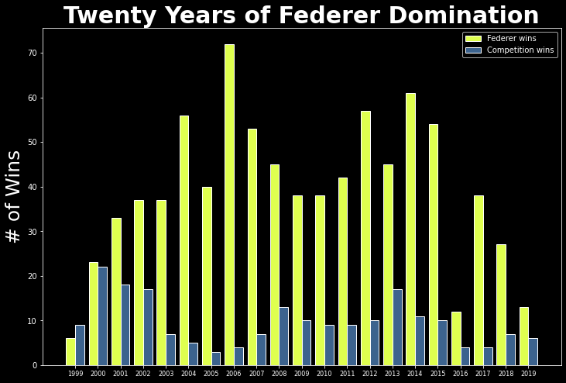
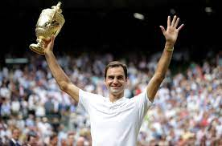
DRIVERS OF GREATNESS
Roger Federer # 1
of 13 ATP Max Rank 1 Players
Record : 907 wins - 202 losses
Notes:
As we put weight on these features, we concluded that Roger Federer is the greatest tennis player within this time. This discovery was attributed to being in the top 3 of all player attributes.

Slide 18
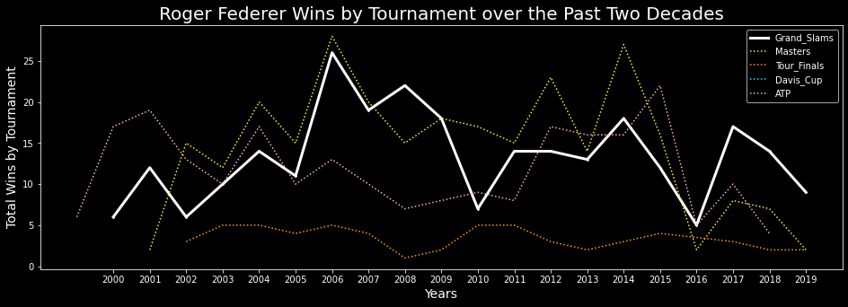
FEDERER
THE GREAT
74% win rate of Top 30 Opponents
20 Grand Slams
Notes:
We explored Federer’s career over the past two decades and it has been nothing but spectacular, highlighting a 74%-win rate on players ranked 30 or higher and winning a total of 20 grand slams

Slide 19
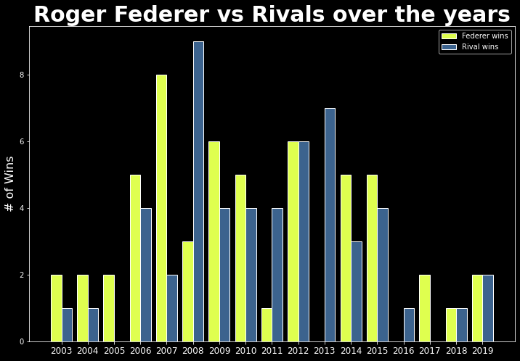
FEDERER &
THE RIVALS
Against Other Rank 1 Players:
Roddick
14 - 3
Murray
10 - 10
Nadal
11 - 19
(Clay 3 -9)
Djokovic
20 - 21
Notes:
He has had many rivalries over the years which has produced the finest tennis matches of all time.
As you can see many players have a higher record then him, including Rafael Nadal who has him beat 9-3 on Clay which is preferable surface for defensive players.
Still though his performance in the key metrics of greatness, makes him the best player within this twenty-year time span

Slide 20
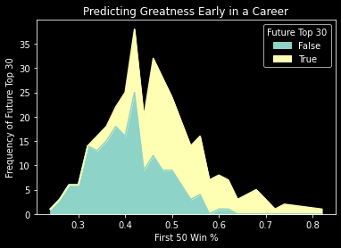
CAN GREATNESS BE PREDICTED EARLY?
Can we predict by first 50 matches?
Top 30 : Yes
Future Champions : No
Notes:
Looking at Federer and his rivals, we asked can greatness be predicted at an early age? Is it natural talent or an evolution through one’s career?
Aggregating all players first 50 matches, we concluded that it is extremely difficult to predetermine future champions. We found trends in predicting top 30 players but within Federer and his 4 rivalries only one of which stood out beyond the mean. Federer, performed within the average in aces and breakpoints, while performing very low in first serve win%, a high loss rate against ranked opponents, and high double fault percentage.

Slide 21
EXPLORATORY SUMMARY
Height and Age
Drivers of Greatness
Clay surface
No significant difference when predicting
- Aces,
- Breakpoints Won
- First Serve Win %
Provides statistical significance when prediction in a match
Notes:
In Conclusion:
We discovered that height and age play no significant difference in match predictions
Drivers of Greatness are based on Aces, Breakpoints, & First Serve Win %
Only Clay surface type is significant for prediction – also as expressed in Feder’s Rivals
Next, we have Chloe to talk about our modeling

Slide 22
MODEL
`
Chloe Whitaker

Slide 23
MODEL OUTLINE
Prepared the data
Created the Baseline
Modeled on no upsets
Created several classification models
Evaluated the best model on the test dataset
Notes:
Thanks Daniel.
Our modeling process to predict match winners is as follows:
We prepared the data for modeling
Created the Baseline to compare our models against
Created a model based on no upsets
Created several classification models evaluating on train and validate before choosing the best one
And finally evaluated on the test dataset

Slide 24
MODEL PREPARATION
Separate into X and y
X = features
y = target
Modeling on:
- rank difference
- rank points
- right and left hand
- clay surface
- head-2-head player1
- head-2-head player2
Notes:
The first step is to prepare.
We separated the data into X and Y where the X represents the features that drive player1 to win, and the y represents the target variable that we are trying to predict which is player_1_wins. This reduces the 91 columns in our dataset down to 7.

Slide 25
BASELINE
Player 2 wins 51% of the time
Baseline accuracy = 51%
Notes:
Before creating our classification models, we created a baseline to compare them to based on assuming player 2 will win, since player 2 wins most often in this dataset.
The baseline accuracy is 51%.

Slide 26
NO UPSET MODEL
Highest ranking player wins = no upset
The highest ranking player win 64% of the time
The accuracy for this model is 64%
Notes:
- To improve on the baseline we created a model based on the assumption that there will be no upsets, and that the highest ranked player will win the match.
- This might seem like a simple model, however it will actually be tough to beat since it is based off a player’s rank they got through winning tournaments and racking up rank points. The best indication we have that a player will win in the future is that they’ve done so consistently in the past.
- The accuracy for this model is 64%.

Slide 27
FEATURES MODEL
Classification Models Built:
Decision Tree
Random Forest
Logistic Regression
Best model = Random Forest
Accuracy =
66% on train
64% on validate
Features Model
Notes:
To try to improve on this model, we built several decision tree, random forest and logistic regression models with varying parameters using the features we identified as drivers of win.
The model that preformed the best was the random forest model with an accuracy of 66% on train and 64% on validate.

Slide 28
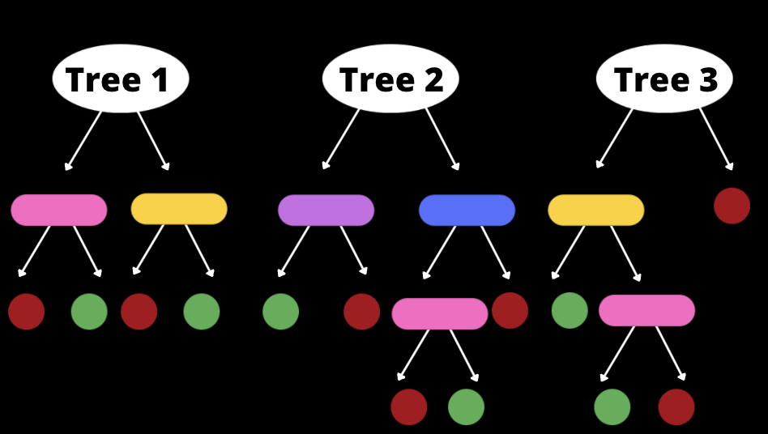
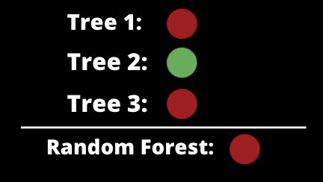
RANDOM FOREST MODEL
A forest is made up of many trees.
Features Model
Notes:
I’ll now explain how our model works.
A random forest model is made up of many decision trees. In classification modeling, the objective is to determine which class an observations fits into. To do this, a decision tree chooses the features that effect the target the most, and asks true false questions until a conclusion is reached.
Many decision trees that use random features and samples make up the random forest model. After each tree has come to its conclusion, the model selects the most common outcome amongst all of the tress as the final decision for the random forest.

Slide 29
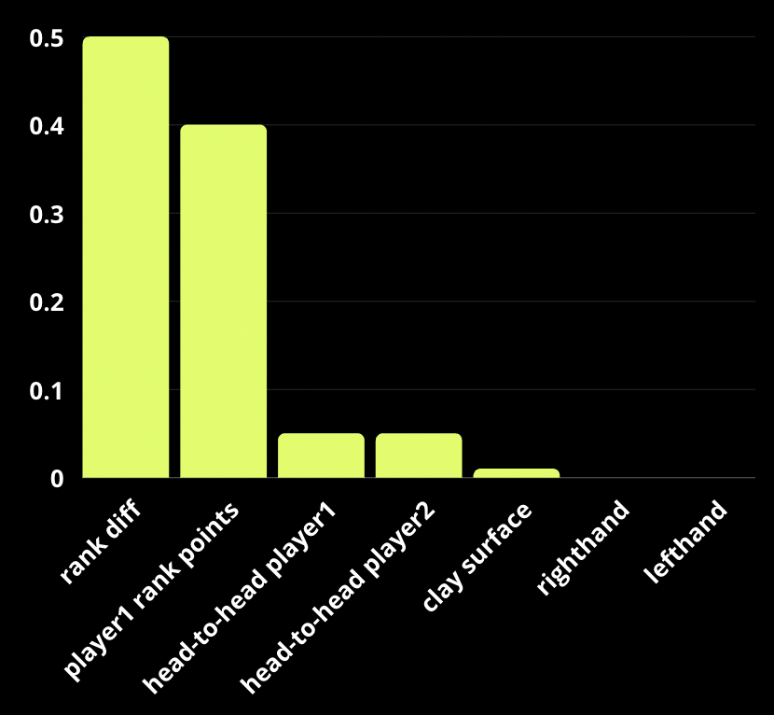
FEATURE IMPORTANCE
Random Forest Feature Importance.
Most Important Features for Predicting if Player 1 wins:
- Rank difference
- Rank points
- Clay surface
- Head to head player1
- Head to head player2
Features Model
Notes:
- The features that our Model found to be most important in predicting player 1 winning were:
- Rank difference
- Rankpoints
- Clay surface
- Head-to-head for players 1 & 2

Slide 30
EVALUATE ON TEST
Evaluated the random forest on test dataset
Test accuracy = 64%.
Same accuracy as upset model
- Beats baseline model by 25%.
Notes:
- Finally, to test our best model on unseen data, we evaluated the random forest on the test dataset.
- Our model predicts the winner accurately 64% of the time.
- This is the same accuracy as our upset model but beats our baseline by 25%.
Alejandro will now wrap up the presentation with our conclusion.

Slide 31
CONCLUSIONS
& NEXT STEPS
`
Alejandro Velasquez
Notes:
Thank you Chloe,
In conclusion
Higher rank players will beat their opponents about 64% of the time. Meaning greatness is thought to beat, even for ML
Roger is has a winning record of 82%
And greatness comes from experience, in reality age is not a factor
With more time we would:
Engineering aggregate features-by-date to improve prediction

Slide 32
CONCLUSIONS
NEXT STEPS
Higher ranked players win more often
(about 64.28% of the time)
Roger victory rate 82%
Players ranked # 1 average a victory rate of 72%
Greatness comes with experience
Engineering more aggregate features-by-date should improve modeling
Notes:
Thank you Chloe,
In conclusion
Higher rank players will beat their opponents about 64% of the time. Meaning greatness is thought to beat, even for ML
Roger is has a winning record of 82%
And greatness comes from experience, in reality age is not a factor
With more time we would:
Engineering aggregate features-by-date to improve prediction

Slide 33
THANKS
Do you have any questions?
GitHub:
https://github.com/Racket-Science/Tennis-Match-Predictions
Notes:
Thank you for your attention, I hope our time with you was insightful.

